Slide 1
Services Architecture Usage Guide v1.40
Rio de Janeiro | April 2015

Slide 2
Version Control
V | Author | Date | Description
1.30 | H. Morais | 06/04/2015 | English Version of v1.3 – Guia de Utilização
1.40 | H. Morais | 07/04/2015 | Added 3 slides in appendix with further details on Execution Framework and Message Canonical Format

Slide 3

This documents describes the patterns & rules which should be followed by the systems which interact with the Oi´s new enterprise service bus.
The major changes to today´s patterns of interaction will be marked with
01 Introduction – Short summary of the new Integration Architecture and of its basic concepts which will be needed to interact with the Enterprise Service Bus.
02 Usage Guidelines – Description of the general usage principles & guidelines needed by consumers and producers of the new services architecture.
Note: The contents of this guide may change slightly with the technical implementation of the Reference Architecture and Execution Framework.
29
Notes:
Versão 1.1 – Adicionou-se ao sumário executivo o fato que as alterações mais significativas serão referenciadas com um ponto de exclamação.

Slide 4
Introduction

Slide 5





Introduction SOA Governance
SOA Governance
In the context of Oi’s SOA Governance initiative a new SOA Reference Architecture was defined.
This initiative also proposed a set of new policies, patterns and processes which would allow the adequate management of Oi’s online integration architecture and thus take advantage of the envisaged benefits, such as those of reuse and standardization of the services implemented in the Enterprise Service Bus.
This document is a Usage Guide for service consumers and providers of the Enterprise Service Bus and describes guidelines and rules which will drive the implementation of Oi’s Service Bus.
ESB
Reference Architecture
Patterns, Policies and Processes

Slide 6

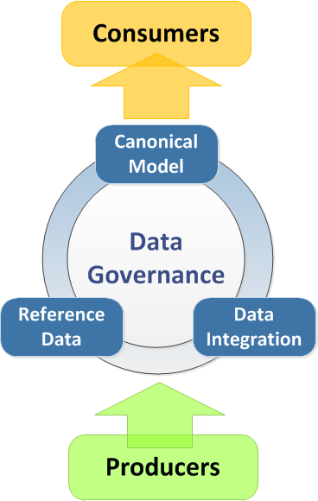
Introduction Data Governance
To adequately manage the identification and development of services at Oi, consumers and producers will interact with 3 areas: (Canonical Model, Reference Data and Data Integration).
The Canonical Model will become the common vocabulary between all systems and/or applications which need to move data through the service bus.
Some of the data attributes of the business entities which will move through the Service Bus are considered Reference Data. These will be managed independently from the Integration team and it will be of the responsibility of a dedicated team to identify and maintain this data and the mapping to the different transaction systems and/or applications which “own” them.
The Integration layer, through this new Services Architecture, will make available to consumers, through services, producers functionality and data.
Notes:
Versão 1.1 - Highlight

Slide 7
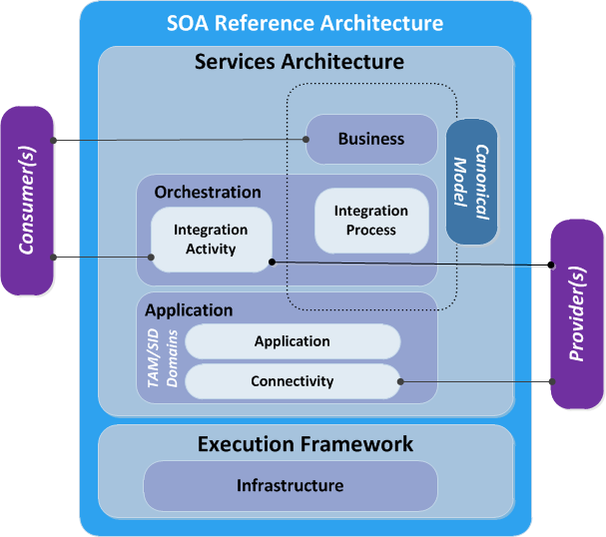
Introduction Reference Architecture
A Reference Architecture defines the structure and patterns to be used and identifies the layers and components needed for the implementation of a Service Oriented Architecture (SOA).
One of these layers, the Services Architecture, (aka Runtime), makes available all of the common integration capabilities of a ESB (Enterprise Service Bus), such as Validation, Enrichment, Transformation, Routing and Operations (VETRO Pattern) and the communication patterns needed for implementing integration services.
An Execution Framework will also make available reusable services and capabilities (aka Infrastructure Services) such as Logging, Error Management or Reference Data Translation to the Services Architecture. These capabilities will be used through Development Templates.

Slide 8
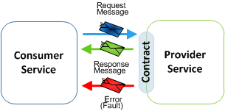
Introduction General Concepts on Services
A Service is a software component which makes available to a consumer a specific functionality (or information) from one or more provider systems (or applications).
The consumer requests this functionality through messages. The Service Bus is the intermediate of this communication flow.
It is through a well-defined Contract (i.e. WSDL) that we can communicate the functionalities delivered to a consumer, which must have 3 views (3S) : Semantics, Syntax, SLA
Views | Description/Questions to be answered
Semantics | What does the service do? What does each message attribute mean, what is the service error behavior, what needs to be monitored, etc…
Syntax | WSDL documents, XML Schemas, Validation Rules, Transport details
SLA | When is it available? Availability %? Guaranteed delivery? Performance base (requests/s), when will it be de “deprecated” or deactivated?

Slide 9
Introduction Communication Patterns
The Services Architecture will support different communication (interaction) patterns, which will be available both to service consumers and producers.
Synchronous
The consumer waits for a response from the provider, before resuming the execution flow. This pattern can be supported by a synchronous our asynchronous interface.
Asynchronous
The consumer delegates the control of the execution flow to the provider after the request. The response is initiated by the provider with a request to the consumer when initial request completes.
Publish/Subscribe
The consumer sends (publishes) a request to multiple providers and subscribes to receive multiple responses.
Notes:
Versão 1.1 – Retirou-se o padrão Fire/Forget

Slide 10
Introduction Error Management
The Services Architecture will support the following error management strategies to manage all errors which may occur in the Service Bus.
Strategy | Type | Strategy Description
Retry | Prevention | Based on the management information related to each error or framework return code, the architecture components will retry the requests automatically, allowing this way to recover from certain error situations without human intervention.
Rethrow to Consumer | Treatment | If the request in error can not be retried, the error will be rethrown to the consumer in a standard way, using a common error model, where the correct treatment action can be performed to manage the erro.
Compensation | Treatment | In special cases, it may be required to apply a compensation strategy, to undo activities already executed in providers. The actions will be the opposite of the already executed. (NOTE: The use of this strategy must be reviewed and approved by the SOA Governance Committee, as one prefers the use of transactional resources).
Notes:
Versão 1.1 – Alteração da Nota na estratégia de Compensação.
Notas: Nenhuma outra estratégia de Tratamento de Erros é previsto no barramento (tal como republicação manual no barramento)

Slide 11
Introduction Service Versioning
As mentioned, a service contract defines the benefits (functionality and/or information made available) and the obligations (messages, protocols, SLAs, etc..) between 2 parties: the consumer and provider of a service. Every time this contract is changed, both parties must be aware of those changes. Because of this, the below versioning strategy will be followed by the Services Architecture.
Tipo | # (e.g.) | Descrição
Major | X.0.0 (1.0.0) | Contract change which ceases to be “backward compatible”. There is impacts on the consumers.
Minor | x.X.0 (1.1.0) | Change which is “backward compatible”, i.e. does not affect the consumers.
Revision | x.x.X (1.1.1) | The contract doesn’t change, this is normally used when only the implementation of the service changes.
Note: Only Major versions require the change of the service end-point, i.e. only the Major # will be included in the contract (WSDL, XSD). Other changes will only be reflected in the service documentation and repository.

Slide 12
Usage Guidelines

Slide 13
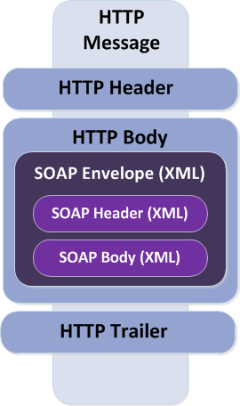
Usage Guidelines Communication protocols & WS-* Specs
# 01
The Base Protocols which will be supported by the Services Architecture are the following:
SOAP over HTTP* | SOAP messages over the HTTP transport
SOAP over JMS | SOAP messages over the JMS transport
The following specifications (standards) are supported:
Base WS-I Profiles
WSDL
SOAP
XML
HTTP, HTTPS, JMS
Reliable Secure Profile | v1.0
Basic Security Profile | v1.1
Basic Profile | v1.1, v1.2, v2.0
*This is the “default” protocol of the Architecture's Business Services

Slide 14
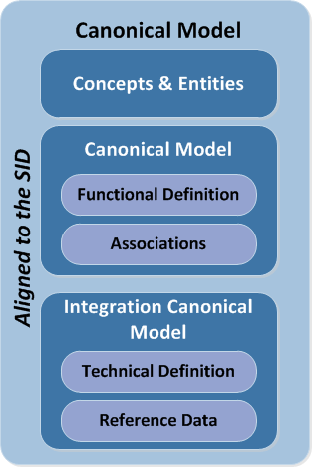
Usage Guidelines Canonical Model
# 02
All Business Services exposed by the Enterprise Service Bus will make use, as message standards, the business data entities based on Oi’s Canonical Model, which is Oi’s logical corporate data model.
The Canonical Model will become the common vocabulary between all systems and/or applications which need to move relevant data through the service bus.
It defines the concepts dictionary (semantics, i.e. meaning) of the organization and identifies the business entities (client, service order, billing account, etc..) aligned to the SID* of TMForum;
It defines the data attributes of each business entity (key attributes, base and extensions), clarifying the related functional definitions and identifies associations between entities through diagrams;
Defines also a technical representation of the data entities (i.e. syntax– type, format, size, etc.. ) and identifies attributes which are data domains (codes), which we also call reference data;
*SID – Shared Information Model, TMForum
Notes:
Versão 1.1 - Highlight

Slide 15
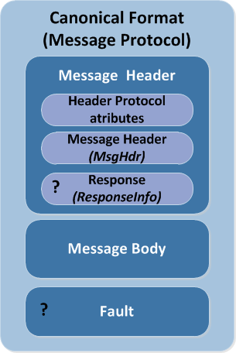
Usage Guidelines Message Canonical Format
# 03
All service consumers or producers which will interact with the Architecture must use as message format the architecture’s standard Canonical Format (which will be related to the message protocol used, i.e. SOAP, XML, etc..)
Two data entities where defined for messages sent or received by the Architecture, to be used in the Message Header of the service request and response messages:
Message Header: Structure which represents a message’s metadata, and which must be present in all messages received and returned by the service operations, be it in synchronous or asynchronous executions.
Response: Metadata structure which propagates the framework’s return code(s) and related information, be it success or error, to be sent to the service consumers or providers which interact with the Architecture;
Notes:
Versão 1.1 – Tornou-se este slide menos dependente do protocolo da mensagem, eliminando-se as referências explícitas ao protocolo de mensagem padrão da arquitetura (SOAP), pois os provedores de serviço/API poderão não suportar. Generalizou-se.

Slide 16
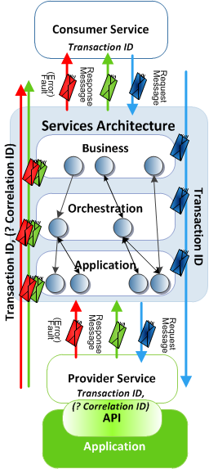
Usage Guidelines Unique Request IDs
# 04
All service consumers which will interact with the Architecture must generate a unique request id (Transaction ID). This id must be unique in the context of the consumer. The service provider(s) will have the responsibility of using this id to provide operations visibility to the end-to-end integration solution.
The Transaction id will be the unique business transaction id of the consumer which initiated the service request. It will allow us to univocally identify the request (message) received by a specific consumer. As it is a technical id, no logic should be implemented making use of it.
In the case the request is made using an asynchronous communication pattern, the provider service must generate a new Transaction id in the response of the service and associate the initial transaction id as the value of the Correlation id attribute of the response.
Notes:
Versão 1.1 - Highlight

Slide 17
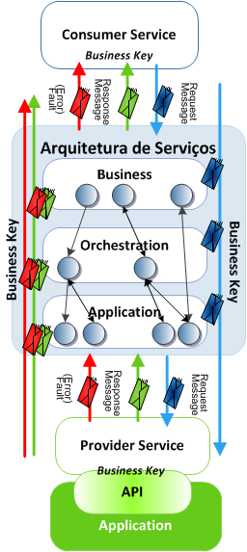
Usage Guidelines Business Key
# 05
All service consumers which will interact with the Architecture must make use of Business Key in the business service requests. This key will identify the business data entities to which the request makes reference.
The Business Key will identify the business entity which is propagated by the services architecture. It will be a functional identifier and will correlate different independent transactions of the integration architecture.
This key should be present in both the requests and related response(s), and should be managed end-to-end.
This key will be composed of one or more identifiers present in the data entities included in the service request and will be defined at design time of the service.

Slide 18
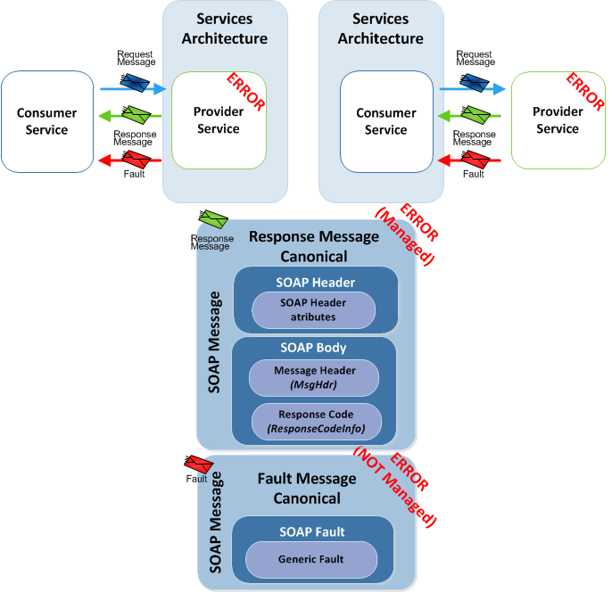
Usage Guidelines Error Management
# 06
All service consumers and providers which interact with the Architecture must manage correctly all errors thrown by the Services Architecture.
A standard metadata structure based on framework return codes (in the Message Header of the Response messages) was defined to facilitate the management of errors by consumers and providers.
The errors returned by service providers must be suficiently atomic and detailed so that, if necessary, retry strategies can be defined in the service bus.
In case errors are thrown by orchestrated services, which make use os several provider services with different APIs, the original errors must be aggregated in the response..
In certain cases, a SOAP Fault (when SOAP is used) may be thrown to the consumer (such as HTTP/JMS transport errors), and these must also be conveniently handled by service consumers.
Notes:
Versão 1.1 - Highlight

Slide 19
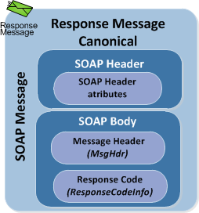
Usage Guidelines Return Code Pattern
# 07
As mentioned, all response messages returned or received by the architecture will have a standard structure. The service return codes will be typified as follow, with errors classified as Business or Technical.
Type | Definition | Description
S | Success | Represents a successful request
T | Technical Error | Indicates that a technical error within the service/api has occurred. These are NOT expected and for which the service consumers can not easily recover as they are dependent of others to correct the root cause of the problem.
N | Business Error | Indicates that a functional or business error occurred. Expected by the service business logic (e.g. Client already exists, Client in churn, etc…). They are expected errors (i.e. they can be defined in the service contract) and are those for which a consumer can normally recover.
A | Warning | Indicates that a warning has occurred (e.g. request already processed), but the request was processed successful (but with some restrictions).
The return codes sent by providers must have a univocal semantic (i.e. one code = a cross-cutting meaning to the system and/or application).

Slide 20
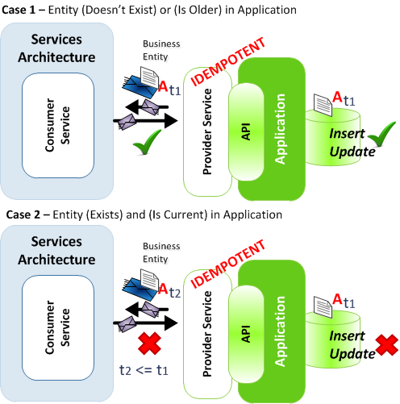
Usage Guidelines Idempotent Provider Services
# 08
All service consumers and providers must demonstrate the idempotence property (i.e. if a request has already been processed by a provider at a previous moment, the request should be ignored).
This requirement is valid for all services which update data in a consumer or provider system (in case they are information “slaves”).
This requirement allows the architecture to retry (or replay) requests in case of errors (or in the case a consumer wrongly sent a request), without putting at risk the consistency of data in the provider or consumer applications.
In case a service consumer or provider encounter this situation, the request must be ignored and a specific error (or warning) thrown and communicated.
Notes:
Versão 1.1 – Highlight

Slide 21
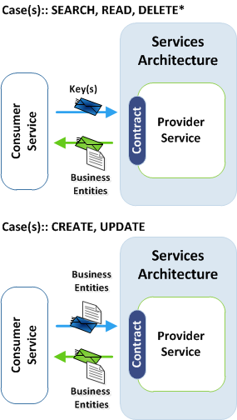
Usage Guidelines Operation Pattern
# 09
The architecture’s Business Services will provide canonical messages based on canonical business entities using the following interaction pattern per type of service operation.
SEARCH, READ, DELETE* Case(s)
The service consumer will send in the request message one or more entity keys (e.g. clientId, serviceId, etc..) and will receive from the Services Architecture one or more complete Business Entities in the response message.
CREATE, UPDATE Case(s)
The service consumer will send in the request message one or more complete** Business Entities (e.g. Client, Service, etc..) and will receive from the Services Architecture one or more complete Business Entities in the response message.
*DELETE – A DELETE operation does not normally exist (applies to a logical delete)
** “Complete” – For the CU operations only some attributes are required but the Return must have the Master Image
Notes:
Versão 1.1 – Highlight

Slide 22
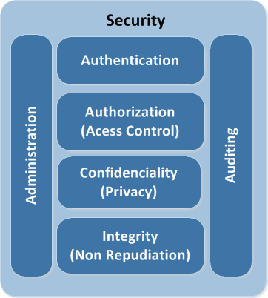
Usage Guidelines Security
# 10
The concept of integration security is not very different of information security. One can implement security in the architecture at 2 levels: Message-level or Transport-level security. As base requirement, all systems and/or applications which are service consumers or providers to the architecture must implement transport-level security.
The following security capabilities must be provided and guaranteed between the service consuming or providing systems and/or applications and the Services Architecture (Service Bus) :
Authentication: Server-based authentication through SSL/TLS with digital certificates between all servers involved in service transactions.;
Confidentiality & Integrity: Transport-level message encryption with SSL/TLS Encryption;
Auditing: All service providers must guarantee that all messages are audited at entry/exit points of the service (full request/response messages – i.e. Header and Body);
Notes:
Versão 1.1 - Highlight

Slide 23
Usage Guidelines Summary
In summary, the key guidelines which must be followed by service consumers and producers which will interact with the new SOA integration architecture are the following::
Use of the business entities of the Canonical Model as basis for the services messages;
Use of a standard format (canonical) for the service messages;
Use of a unique request id (Transaction ID) generated by service consumers which will be used to facilitate the end-to-end operations of an integration transaction;
Extensive and coherent service error management by both service consumers and providers;
Services which alter system corporate data must be idempotent, to guarantee consistency of data in the corporate systems;
One demands that Oi’s integration architecture is secure, so at a minimum, transport-level security must be implemented in all interactions between consumers or providers of the enterprise service bus.
Notes:
Versão 1.1 – Novo slide

Slide 25
Appendix

Slide 26
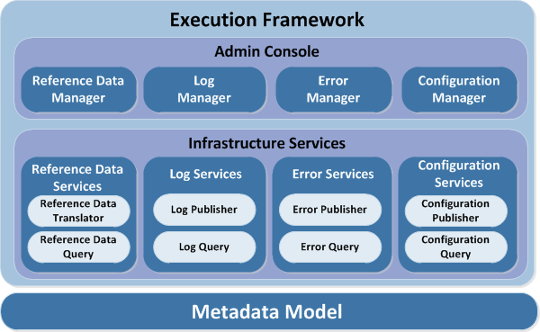
Services Architecture Execution Framework
The Execution Framework provides reusable capabilities to the Services Architecture and is decomposed in 3 layers:
Administrative Console
Web Application which will manage the framework´s components and will provide support to the operation of the Services Architecture.
Infrastructure Services
“Application” or/and technical components which will support the Services Architecture, such as Logging, Error Handling, Configuration and Code/Decode.
Metadata Model
These are data entities which will support the execution framework.

Slide 27

Message Canonical Format Message Header
Attribute | Definition | Description
TransactionId | Transaction ID | Business Transaction ID of the consumer which iniatied the service request
CorrelationId | Correlation ID | ID which allows request or messages to correlated in na assyncronous context
BusinessKey | Business ID | Business Functional ID for the transaction.. It will allow the functional identification of the transaction.
Credentials |  | Metadata structure to store service consumer credentials
AppId | Application ID | Application ID which made the service request (i.e service consumer)
AppToken | Application Token | Hash Key with the Application credential
UserId | User ID | User ID which made the request
UserToken | User Token | Hash Key with the User credential
Timestamp | Date/Time | UT Date and Time (HHmmssSSS) for the creation of the request
LogKey | Log Key | Business ID to be used internally by the Execution Framework for for logging and monitoring traceability.
Parameters | Optional Parameters | Key/Value pairs with functional or technical information to be used as wished by the service consumers
NOTE: May suffer slight changes with the Execution Framework implementation

Slide 28
Message Canonical Format Response
Attribute | Definition | Description
Type | Return Type | Represents the type of return from the Framework´s service (Success, Error, Warning, etc...)
Code | Return Code | Represents the Framework´s return code
Description | Return Message | Represents the framework’s message related do the return code
Native Return[ ] |  | Lsit of Return Codes of the different Provider APIs
AppId | Application ID | Application code which identifies the application which returned the return code
Type | Return Type | Represents the type of return from the API (success, error, etc…)
Code | API Return Code | Represents the Application API’s return code
Description | Return Message | Message related do the return code from the API
Details | Extra details Message | Extra details to the message returned from the API (Exception, etc…)
NOTE: May suffer slight changes with the Execution Framework implementation

